Slide 1
Pre-reading Recap
What is NoSQL?
NoSQL: (Not only Sequel) NoSQL is an umbrella term to describe any alternative system to traditional SQL databases.
NoSQL databases are all quite different from SQL databases
What is MongoDB?
A database, meaning a structured way to store and access data.
More specifically, it is a NoSQL database. NoSQL is a very generic term used to describe any data store that doesn't use legacy approach of related tables of data. This means that you're storing your data in an organized way, but not in rows and columns An example of NoSQL databases can be anything from a library card catalogue , to a more sophisticated data store like MongoDB.
How does MongoDB Stores data ?
MongoDB is a NoSQL document database.
This means that data in MongoDB is stored as documents. These documents are in turn stored in what we call collections of documents. That's why MongoDB is categorized as a NoSQL document database. In conclusion, the MongoDB database is a NoSQL Database.
What is a document?
It is a way to organise and store data as a set of {field:value} pairs
JSON? Stands for JavaScript Object Notation, starts and ends with curly {} braces, key and value are separated by a colon, and each key {key:value} value pair is separated by a comma
and a "key" must be enclosed in quotation marks. However, in MongoDB keys are called fields.

Slide 2
NoSQL: Pre-reading Recap
BSON?: stands for Binary JSON
JSON and BSON are close cousins, as their nearly identical names imply, but you wouldn’t know it by looking at them side-by-side.
JSON, or JavaScript Object Notation, is the wildly popular standard for data interchange on the web, on which BSON is based on (Binary JSON).
BSON differs from JSON is in its support for some more advanced types of data. JavaScript does not, for instance, differentiate between integers (which are round numbers), and floating-point numbers (which have decimal precision to various degrees).
Format BSON VS JSON: Data in MongoDB is stored in BSON but viewed in JSON, BSON is great but not human readable to export and transfer data to different system or cluster the best bet is to export it in BSON because it is lighter and faster. However, for viewing and reading a human readable JSON is a better choice.
JSON Data Types: String, Boolean, Number, Array.
JSON Readability: Human and Machine
BSON Data Types: String, Boolean, Number (Integer, Float, Long, Decimal128...), Array, Date, Raw Binary.
BSON Readability: Machine Only
"_id" unique identifier for a document in a collection
"_id" is required for every DB Document
ObjectId() the default value for "_id" field unless otherwise specified

Slide 3
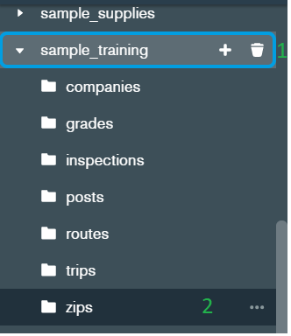

Focus Area: Read
Creating and manipulating documents
Create Read
Insert Update Delete
Data Explorer: Namespace - The concatenation of the database name and collection name is called a namespace. For example, sample_training.zips
Basic query
In MongoDB Compass
1. Select the sample_training database, then the zips collection
Enter
{"state": "NY"}
→ click the “Find” button in green as shown below to display document(s)
B. {"state": "NY", "city": "ALBANY"}
→ click the “Find” button in green as shown below to display document(s)
Exercise
Select the sample_training database, then trips collection to find a person with birth year 1961, who took a trip that started at "Howard St & Centre St".
{"start station name" : "Howard St & Centre St", "birth year" : 1961}

Slide 4
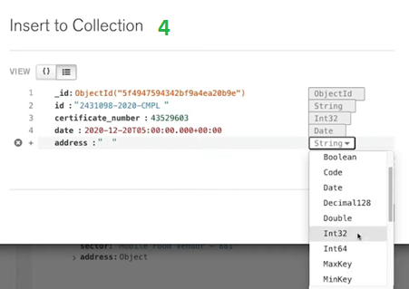
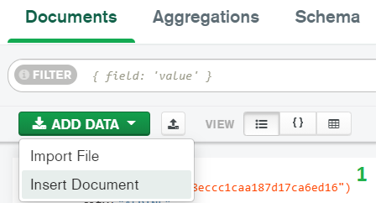
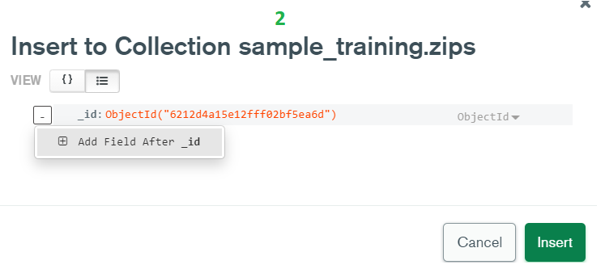
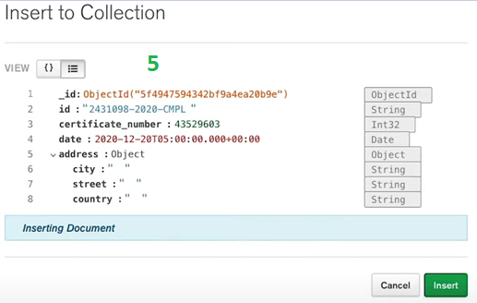
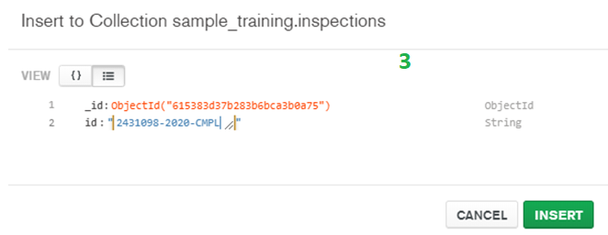
Focus Area: Create
Creating and manipulating documents
Create
Read
Update Delete

Slide 5
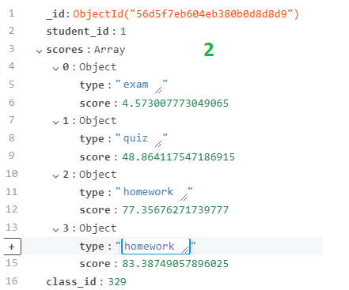
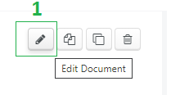
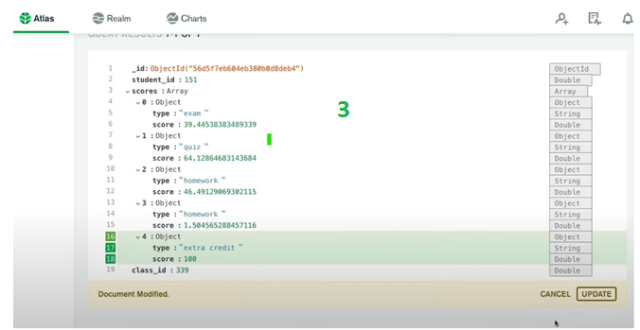
Focus Area: Update
Creating and manipulating documents Create
Read Update Delete

Slide 6
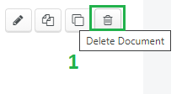
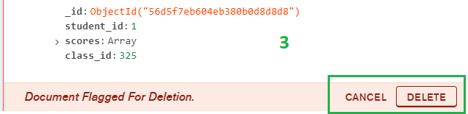
Focus Area: Delete
Creating and manipulating documents Create
Read Update Delete

Slide 7
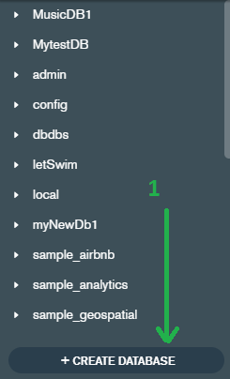
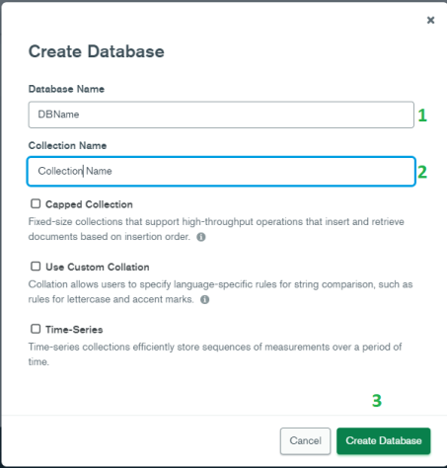
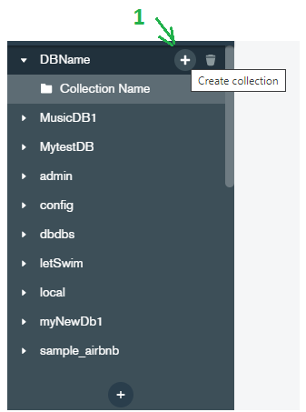
Focus Area: Create DB GUI

Slide 8
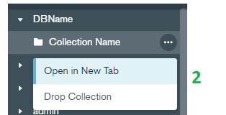
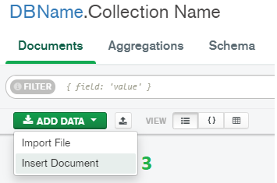

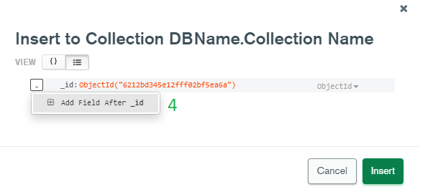
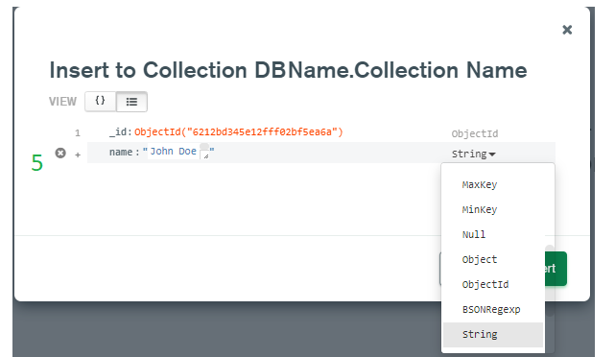
Focus Area: Create DB GUI

Slide 9
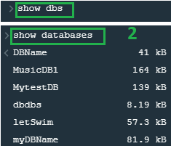


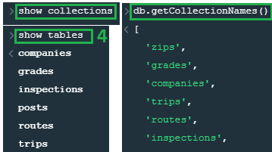
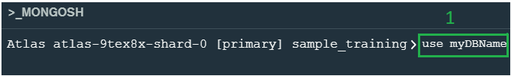



Focus Area Mongosh: Mongo Shell
Select MONGOSH(Mongo Shell)
Enter the “show dbs” or “show databases” command : to display the list of
databases in the cluster.
Enter the “use database” command: to select the database you will be using.
Enter “show collections” or “show tables” or “db.getCollectionNames()”
command: to display a list of all the collections(tables) in the database.
MongoShell is also a fully functioning JS interpreter.
To create a database, enter the “use nameOfDB” as shown below and continue with the remaining steps.

Slide 10



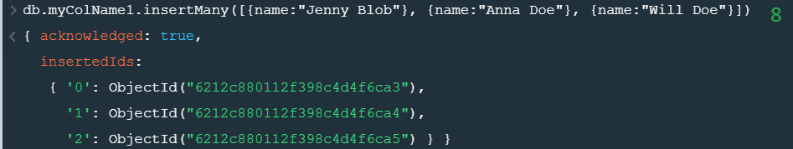
Focus Area Mongosh: Create
Below is how to create a collection or collections in a database
Below is how to insert a single document into a collection
Below is how to insert multiple documents into a collection by using an array

Slide 11



Focus Area Mongosh: Read
Below is how to read a document or all documents in a collections in a database
Below is how to read a specific document in a collections in a database Or just the first one
Below is how to count all documents in a collections in a database
Specify which fields to return by passing a field selection parameter

Slide 12
Focus Area Mongosh: Update
Below is how to use the proportional $ operator to update a value in a document
Below is how to use the proportional $ operator to update a multiple value in a multiple documents
Just like with the set operator, if the field that is specified doesn't exist in the document, then $push will add an array field to the document with a specified value.

Slide 13



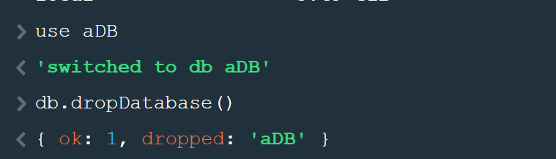
Focus Area Mongosh: Delete
Delete one document that has name field equal to Carlor Robeto.
Delete all the documents that have gender field equal to F.
Drop the all documents in the items collection and the item collection itself.
To Drop database

